Slide 1

K-Means
Presented by:
Elizer Ponio Jr.
Department of Computer Science
College of Computing and Information Technologies

Slide 2
K-Means
In K-Means clustering, data is grouped in terms of characteristics and similarities.
K is a letter that represents the number of clusters.
For example, if K=5, then the number of desired clusters is 5. If K=10, then the number of desired clusters is 10.
Notes:
Have you asked yourself the question, why do people organize?
Lets go to the psychology of organizing
This predictability applies within the context of our homes, manifesting through the concept of organization

Slide 3
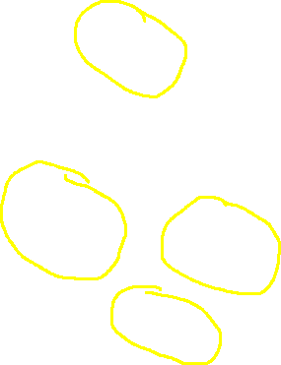
Step 1:
Select the number of clusters you want to identify in your data. This is the K in K-Means clustering
Notes:
Have you asked yourself the question, why do people organize?
Lets go to the psychology of organizing
This predictability applies within the context of our homes, manifesting through the concept of organization

Slide 4




Step 2: Randomly select K distinct data points. These are the initial clusters
Notes:
Have you asked yourself the question, why do people organize?
Lets go to the psychology of organizing
This predictability applies within the context of our homes, manifesting through the concept of organization

Slide 5
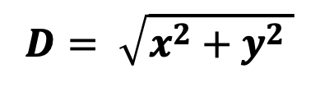

Step 3: Measure the Euclidean distance between the first point and the initial clusters
$$D= \sqrt{x^{2}+y^{2} }$$
Notes:
Have you asked yourself the question, why do people organize?
Lets go to the psychology of organizing
This predictability applies within the context of our homes, manifesting through the concept of organization

Slide 6

Step 4: Assign the first point to the nearest cluster.
Notes:
Have you asked yourself the question, why do people organize?
Lets go to the psychology of organizing
This predictability applies within the context of our homes, manifesting through the concept of organization

Slide 7
Step 4: Assign the first point to the nearest cluster. Do this for all data points
Notes:
Have you asked yourself the question, why do people organize?
Lets go to the psychology of organizing
This predictability applies within the context of our homes, manifesting through the concept of organization

Slide 8




Step 5:
Find the centroid by calculating the center or mean of each cluster
X
X
X
X
Notes:
Have you asked yourself the question, why do people organize?
Lets go to the psychology of organizing
This predictability applies within the context of our homes, manifesting through the concept of organization

Slide 9
How to Choose the Value of "K number of clusters" in K-Means Clustering?
Notes:
Have you asked yourself the question, why do people organize?
Lets go to the psychology of organizing
This predictability applies within the context of our homes, manifesting through the concept of organization

Slide 10
Choosing the value of K
Although there are many choices available for choosing the optimal number of clusters, the Elbow Method is one of the most popular and appropriate methods.
The Elbow Method uses the idea of WCSS value, which is short for for Within Cluster Sum of Squares.
WCSS defines the total number of variations within a cluster
Notes:
Have you asked yourself the question, why do people organize?
Lets go to the psychology of organizing
This predictability applies within the context of our homes, manifesting through the concept of organization

Slide 11
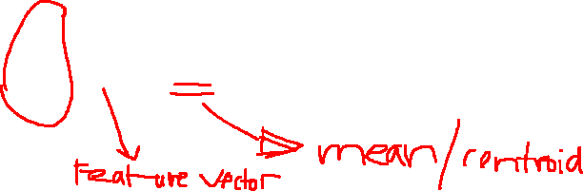
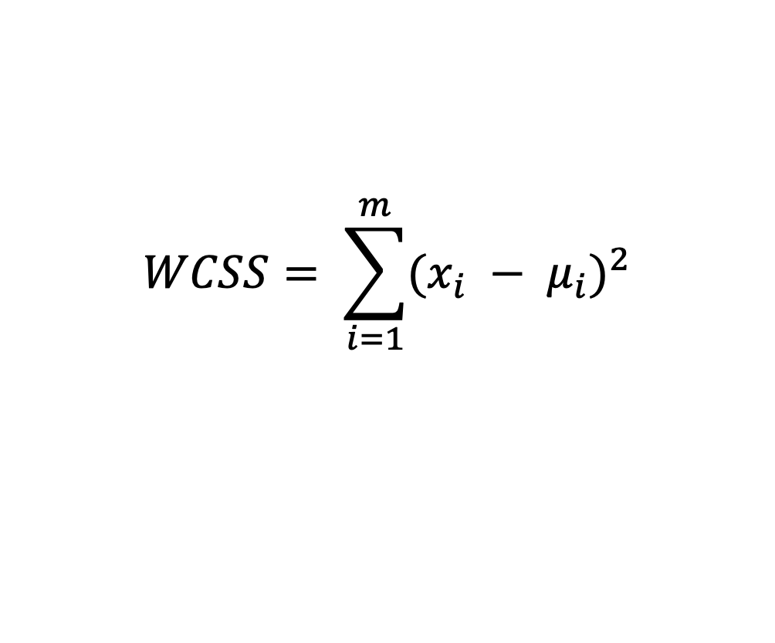
Choosing the value of K
The K-means algorithm aims at keeping the WCSS at a minimum level.
k-means clustering aims to partition the number observations into K clusters so as to minimize the within-cluster sum of squares (WCSS)
$$WCSS= \sum_{i=1}^{m}{{(x_{i} − μ_{i})}^{2}}$$
Notes:
Have you asked yourself the question, why do people organize?
Lets go to the psychology of organizing
This predictability applies within the context of our homes, manifesting through the concept of organization

Slide 12
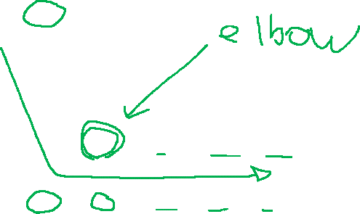
Choosing the value of K
wcss
Number of Clusters (K)
Notes:
Have you asked yourself the question, why do people organize?
Lets go to the psychology of organizing
This predictability applies within the context of our homes, manifesting through the concept of organization

